Slide 1
Situation Analysis of Chinese Elderly Service Workers and Social Workers
Zhang Mingsuo
Professor，Doctoral Supervisor
School of Public Administration，
Zhengzhou University

Slide 2
Ⅰ Social Background
The elderly service personnel include not only the managers of all kinds of the elderly service institutions, but also the professional, technical, skilled personnel engaged in medical care, rehabilitation, nursing, nutrition, psychological and social work for the aged.
At present, China has entered a stage of highly aging. By the end of 2017, the number of people over 60 years old in China has reached 240.9 million, accounting for 17.3% of the population, of which people over 65 years old is 158.31 million, accounting for 11.4%. It is characterized by the accelerating growth of the elderly population, the highly increase of the elderly and the disabled, as well the increasingly prominent trend of empty nesting and miniaturization.

Slide 3
Ⅱ.Poor quantity and quality of the service providers
1.Huge gaps in elderly services
If only 40 million disabled or mentally handicapped elderly people were provided with caregivers in a ratio of 3:1, China will need tens of millions of the elderly care service staff, and now there are nearly 300,000 staff in the elderly care institutions.
Beijing:
By the end of 2016, the number of elderly residents aged 60 and over in the city was 3.292 million, accounting for 24.1% of the total registered population, ranking second in the country.
Elderly people with dementia occupied about 5% to 6%. In terms of skilled caring personnels, according to the Opinions on Strengthening the Construction of Endowment Service Personnels issued by the Civil Affairs Bureau in early 2017, there were about 7,000 elderly caregivers in the city with a gap of 23,000.

Slide 4
Shanghai:
What is the amount of lack service peopel in Shanghai's pension agencies? there is no precise statistics, Zhang Fan, deputy director of the Social Welfare Department of the Civil Affairs Bureau said. However, according to the latest data, by the end of 2017, there were 4.836 million elderly people over the age of 60 in Shanghai, occupying 33.2% of the total population; 3.176 million elderly people over 65 years old, taking up 21.8% of the total population; 805.8 thousand elderly people over 80 years old people accounting for 5.5% of the total population and 16.7% of the elderly population. In the light of the calculation of 6.7% of the elderly residents with disability and dementia, there are more than 320,000 disabled people in Shanghai. If they are equipped with 3:1, they need more than 100,000 caregivers.

Slide 5
Tianjin：
for example: As of June 2015, Tianjin's elderly care service institutions had a total of 4,103 elderly caregivers (including elderly caregivers, nutritional social workers, medical rehabilitation personnel, etc.), and about 51,204 elderly people settled in. Obviously, the allocation ratio of the elderly and the caregiver was about 12:1, which was much higher than the standard, that the caregivers taking care of no more than 8 self-care elderly people, and 4 disabled elderly people, from the Tianjin Aged Care Organization Management Measures in 2007.
Guangzhou:
By the end of 2016, there were 1.546 million elderly people in Guangzhou, and only 4,619 elderly caregivers in the city's elderly care service institutions. There were still 12,300 caregivers in need, with a gap of more than 7,000.

Slide 6
2. The overall level of education and specialization is relatively low.
China：
The 2013 China Civil Affairs Statistical Yearbook shows that as of the end of 2012, there were 293,674 employees at the end of the year, including 159,111 female employees, accounting for 51.2% of the total number of employees.
In terms of education level: there were 239,117 people graduating from technical secondary school, high school and the following, accounting for 81.4% of the total number of employees; meanwhile there were 39,841 and 14,716 were college, undergraduate and above graduates, accounting for 1.36% and 5% of the total number of employees.
About age structure: caregivers whose age between the 36 and 45 years old were the main component. Specifically, the number of workers aged 35 years old and below was 73559, accounting for 25% of the total number of employees. the number of workers aged 36 to 45, 46 to 55 and over 56 years old was 119,422, 82,726, 17,967, accounting for 40.7%, 28.2% and 6.1% of the total number of employees.

Slide 7
Among the 300,000 elderly caregivers all over China, there were only 50,000 elderly caregivers who have obtained the professional qualification certificate. Among them, 3,283 people obtained professional qualification certificates for social workers accounting for 1.1% of the total employees (including 1825 assistant social workers and 1458 social workers).
Tianjin:
By the end of 2016, more than 98% of the nursing staff were graduated from high school and below. In the meanwhile, most of them were migrant workers in rural areas. However the “40” and “50” personnel in the original cities were currently facing pension problems, with more than 80% of people aged 40. As we all know, these people could meet the most basic needs of the elderly for life care, but it is difficult to provide high-quality elderly care services such as rehabilitation care, psychological care and health management for the elderly.
Henan:
According to statistics in 2013, there were about 17,000 elderly care workers in Henan Province, of which more than 90% did not have a certificate of practice while lacking professional nursing knowledge.

Slide 8
3.Enrolling students for the major of pension service is difficult, and the rate of loss of service personnel in the pension agency is high.
For example, the elderly service institutions generally have been facing difficulties in recruiting workers, and it is very hard to attracting high-quality or retaining personnel. What’s more, high-quality talents are less likely to engage in nursing care jobs even if they stay in the institution.
It is a really hard time for recruiting new students for the major of senior service and management in higher vocational and technical colleges.
According to the dean of Senior Welfare Institute of Beijing Social Management Vocational College, ①in 2016, we were planning to develop two classes for the elderly profession. However we only recruited 20 people during the self-enrollment stage. What’s worse, most schools only recruited single digits. Among them, a college in Xingtai planed to enroll 50 students, but only recruited one student in the end, and the student could only attend classes with the nursing major.

Slide 9
②From the perspective of the development of national pension education, the loss rate of students in the first year of employment may reach 30%, 50% in the second year, 70% in the third year or even higher.
Some have just abandoned their entry into the elderly care institutions just after graduation, and some have chosen to change careers during their work, including personal entrepreneurship, corporate administration, advertising sales, etc. All in all, the scale of personnels who actually stay in the elderly service institutions is very scant.

Slide 10
Ⅲ the Direct Cause of the Shortage of Elderly Service Personnel
1.Heavy Labor and Dirty Work
Most of the residents in the elderly care institutions are incapacitated or mentally handicapped who cannot take care of themselves. The institutions need to provide almost all-day services. In addition, the number of elderly care service staff is small, so the labor intensity of institutional service personnel is relatively great, and it is difficult for them to rest during legal holidays. （1）Most elderly people in the old-age institutions are disabled and mentally retarded who can‘t take care of themselves. They need be provided all-weather services, but staff are very few. Therefore, the labor intensity of service personnel is high, and statutory holidays are hard to be guaranteed. （2）The elderly people who can not take care of themselves need help in their lives including eating, drinking water, sleeping, shit.If the elderly people do not defecate many days, service personnel need to help the elderly defecate, even "scratch" with hands and without auxiliary tools. This service usually does not always happen, but it is a regular job. If you accept the disabled person suffering from bedsore, the old man scolds a few words, pinches, scratches, and even bites you will often happen. Therefore, the current nursing service is a dirty, tired, and ungrateful job.

Slide 11
Eight students from the Beijing Vocational College of Social Management spent six months interning in a nursing home, leaving only half of them finally. They generally complain too long workhours, heavy workloads, poor day and night breaks, fewer nurses, and heavy tasks.........
2. Higher risk and higher pressure
In the old-age institutions, most elderly people are living in high-risk like falling, chokeing, lost and other accidents. Once an accident happens, the person in charge of the organization on duty should bear the responsibility and compensate for the loss. This has also caused great pressure on the person in charge of the organization and the service personnel.
Jiang Fei, the director of the Riyuetan Pension Center in Jinan, Shandong Province, told reporters, "Four years since he open the center,he spends
thousands to tens of thousands for compensating for elderly people every year."A compensation case in a nursing home may be dried up in a year. A small nursing home may go bankrupt in a lawsuit. " Yu Aifang, a caregiver in Jinan Yanliu Old-age Apartment, said: An old man who turns around, squats down, and even eats food can cause fractures. This makes us very afraid every day.

Slide 12
3.Low Salary
As a nursing staff, they need to work 8 to 12 hours a day. In addition to daily life care, they also need to have a professional knowledge similar to a babysitter. But their salary perhaps only is 3,000yuan. that‘s the salary status for most urban old-age caregivers. The income of nursing staff in rural old-age institutions is lower, generally around 1500 - 2000yuan.
Beijing
Liu Hao, a post-90s nurse from the Financial Street Old-age Apartment, graduated from Beijing Jingbei Vocational and Technical College,saying his monthly salary is about 3,000 yuan After deducting social security fund.
Guangzhou
Most Guangzhou's old-age caregivers earn between 3000 and 4000 yuan. This price has no advantage. Many people prefer to be nannies.
Rural Henan: Chang Yuqing is a nursing staff in Lushan County, Henan Province, who is responsible for more than 20 elderly men who can not take care of themselves. He stays with the old man at 7 o'clock every morning to 5 o'clock the next morning, not sleeping.He can earn 1500 yuan a month.

Slide 13
4. Low Social Status and Poor Reputation
Due to the hard work, high risk and low income of the old-age service staff, most of the nursing staff are temporary workers without social security, so the professional prestige is very poor. In addition, the traditional concept that care is a serviceing other people‘s work, parents generally oppose young people to engage in pension services.
A public pension apartment in Anyang City, Henan Province, said, "The main problem is that there are fewer nurses, and it is easy to losing. The service reputation of the elderly people service is poor. Many girls think that it is not easy to get married. "Graduates studying professional nursing now prefer to work as nurses in public hospitals rather than as nurses in pension institutions." The heads of several private pension institutions in Luoyang also shared similar problems.

Slide 14
Ⅳ The deep-seated reasons for the shortage of elderly service personnel.
1.Private pension institutions are short of funds and government subsidies are not enough to pay high wages.
Most pension institutions face two financial difficulties: first, high investment. The old-age service institutions have long return cycle, high risk, and welfare property can not be used for mortgage, so the general banks are unwilling to provide loans,the fund function through the deceased borrowing and other means. For example, a small and medium-sized private old-age care institution with 30 beds needs 9 million yuan to invest in land use, housing construction, old-age equipment, supporting measures and so on. Since most of the funds are private loans, the old-age home only pays interest as high as 30,0000yuan per year.Second, theu can't make ends meet during operation. At present, the main source of income of private pension institutions is collecting the fees for the elderly and government subsidies.

Slide 15
Because the government's support is closely related to the level of economic development in the region and the level of economic development is backward in less developed areas, the government's investment in private pension odd and even shares can not meet the development needs of institutions. Only those who support the funds can not be in place in time . Therefore, the organization can not afford to pay higher wages for employees.
For example, as early as 2011, the Henan Provincial Government promulgated the "Opinions on Innovating Investment and Financing Mechanisms to Guide Social Investment" pointed out: for non-profit pension institutions, in the construction period, according to the total investment, construction scale, rent period and other indicators to give subsidies, in the operation period according to the approved number of beds, adoptions, occupancy rate and other indicators.

Slide 16
Operating subsidies are awarded. Generally speaking, with the support of a series of fiscal policies, private pension institutions should speed up their development, which is not the case, according to some private institutions.According to the reflection of the private pension institutions, the subsidy policy has not been implemented.
Private old-age institutions have higher initial investment, higher operating costs, longer payback period, less state policies than public institutions, and the original financial support of the policy has been distorted in the display, making the development of private old-age institutions worse.
In order to survive, private pension institutions are forced to raise the fee standards and raise the living threshold of the elderly, resulting in high vacancy rate of private pension institutions and difficult business operation.

Slide 17
2. most elderly have lower incomes, and the pay ability is limited.
According to our 2015 survey in cities and towns of Henan Province, 6.8% of the elderly without income after retirement, 17.7% of them have income between 0 —1000 yuan, 34.6% have income between 1001 and 2000 yuan, and 10.8% have income above 3000yuan. About the economic burden of the elderly, 43.7% of the elderly have surplus per monthly . 27.6% of the elderly basically budgets, and 12.4% of the elderly live beyond their means.
The pay ability has a great impact on the choice of pension services. Institutional pension accounts for 15.6% in the non-income elderly, 21.0% in the range of 0-3000 yuan, while the majority of the elderly with monthly income more than 3000 yuan choose institutional pension. This shows that the higher the income of the elderly, the more inclined to institutional pension.
According to our survey in Henan Province in 2016, more than 80% of the rural elderly have a monthly fixed income less than 1,000 yuan, 70% of the rural elderly have a monthly income less than 500 yuan, and 13.5% of the elderly have a monthly income more than 1,000 yuan.

Slide 18
Even within the monthly range of 1-500 yuan, most of the elderly's fixed income comes from only a few tens of dollars of endowment insurance, which is not enough to pay for other daily life accidents. When the monthly income of the elderly is more than 500 yuan, with the increase of income denial, the elderly are more likely to choose institutional pension.For the elderly with a monthly income less than 500 yuan and no fixed income, the probability of choosing an institution to provide for the aged is not high, and only maintains at 11%. This shows that the old people in rural areas can not bear the price of pension odd and even shares very well, but can not afford the services of pension institutions, and the effective demand is insufficient.
In the case of low occupancy rate, institutions have to reduce costs through low wages, high-intensity labor, low-level services and other means. Therefore, the key to solve the problem of the shortage of service personnel in private pension institutions is to implement and strengthen the government's financial subsidy policy to the pension service institutions, while increasing the retirement income of the elderly.

Slide 19
V. New policy initiatives
1.Promoting government purchase for aged care services.
Improve the government’s purchase for an aged care service system, guided by the needs of the elderly’s basic aged care services,focus on closely related projects such as life care and rehabilitation care for the elderly,priority should be given to eligible elderly people, low-income seniors, disabled, semi-disabled elderly people with financial difficulties, and elderly families with family planning difficulties in purchasing the corresponding old-age care services;in order to meet the government-funded conditions for the elderly to buy food, bathing, cleaning, emergency, medical assistance, nursing and other on-site services,purchase services such as community day care, rehabilitation services for the elderly.

Slide 20
2.Improve fiscal and tax support policies.
Increase government funding for the development of the aged care service industry, and establish a stable funding mechanism for the funding of old age.Governments at all levels should use more than 50% of the lottery public welfare funds for social welfare undertakings to develop the aged care service industry,and gradually increase the proportion with the increase of the elderly population.Among them, the funds supporting the development of private pension services shall not be less than 30%.Local governments should provide subsidies for accident insurance for elderly people to purchase for the elderly.
3.Through subsidized investment, loan interest subsidies, operating subsidies, and purchase of services, social capital will be guided to organize large-scale and chain-based old-age care institutions, and individuals will be encouraged to organize family-based and small-scale old-age care institutions. We will implement preferential policies for land use, subsidies, tax reductions,and personnel training for socially-established institutions.

Slide 21
4.Build a home community pension service network.
Building and improving the community pension service information platform,to realize the timely and effective docking of information on the supply and demand of various pension service entities such as catering, housekeeping, health and the elderly, provide customized services such as food support, cleaning, bathing, medical assistance, help and emergency, and promote the socialization of home care services.
5.Improve the capacity of rural old-age services.
Strengthen the construction and transformation of rural nursing homes and promote the service facilities to meet the standards,under the premise of meeting the needs of the rural poor people, it provides convenient and accessible elderly services for the rural low-income seniors and disabled and semi-disabled elderly.

Slide 22
6.Cultivate and strengthen healthy and aged care service enterprises.
Actively introduce advanced foreign management models and service concepts,promote the chain and group development of healthy pension enterprises.Encourage the development of healthy old-age industries and related industries, and plan to build a number of leisure and health care, medical rehabilitation and health care industry bases.
7.Relax foreign investment.
On the basis of encouraging foreign investors to organize for-profit pension institutions in China,further liberalize the market,encourage foreign investors to set up non-profit pension institutions,the non-profit pension institution established by it and the non-profit pension institutions established by domestic investors enjoy the same preferential policies.

Slide 23
8.Explore the establishment of a long-term care insurance system.
Piloting the long-term care insurance system,explore the establishment of long-term care and care systems that are linked and complemented by long-term care insurance, long-term commercial care insurance, nursing subsidies, and nursing assistance,enhance the ability of the elderly to receive care and promote the continued development of the care system.
9.Improve the salary and benefits of pensioners.
Explore the establishment of pension service personnel entry subsidies, training subsidies and job subsidies, etc,increase the protection of vocational training, wages and benefits, and social status,open up the channels for the career development of the aged care service talents.Local governments are encouraged to provide subsidies for the purchase of social insurance for elderly care workers.Nursing caregiver into public welfare jobs.

Slide 24
Improve the linkage mechanism between vocational skill level and remuneration package for aged care workers.For professional and technical personnel employed in the old-age institutions, the same professional assessment and promotion policies as those of medical institutions and welfare institutions.
10.Strengthen the education and training of endowment service personnel.
Encourage institutions of higher learning and vocational colleges to set up old professional disciplines such as old-age service management, social work, medical care, nursing rehabilitation, nutritional catering, and psychological counseling.Through the training of orders and the construction of training bases, the nursing staff of the post have been trained in professional skills.Gradually establish a professional manager mechanism for the development of the aged care service industry, and create a group of management-oriented talents in the field of aged care services.

Slide 25
Ⅵ Changes that are taking place
1.The new elderly care industry is booming, attracting a number of young people to transform or join in.
In recent years, with the government‘s attention and the adjustment of industrial structure, the investment boom of old-age caring real estate begins to rise, and estate investor, financial insurance institutions and overseas funds tend to invest old-age caring real estate.
Residential, health, medical care, culture,old care and other functions are all set inside the old-age caring real estate projects. Due to the beautiful environment, advanced service facilities and thick cultural atmosphere, some buyers are attracted to purchase. It also provides a platform for a large number of young elderly care service personnel with professional background. The post-80s and post-90s generation have become the main force in some emerging old-age care institutions.

Slide 26


杭州乌镇雅园
集养生居住区、颐乐学院、养老示范区、医疗公园、特色商业区和度假酒店区六大板块于一体。

Slide 27

蕾娜范（烟台）养老服务有限公司(外国法人独资)

Slide 28

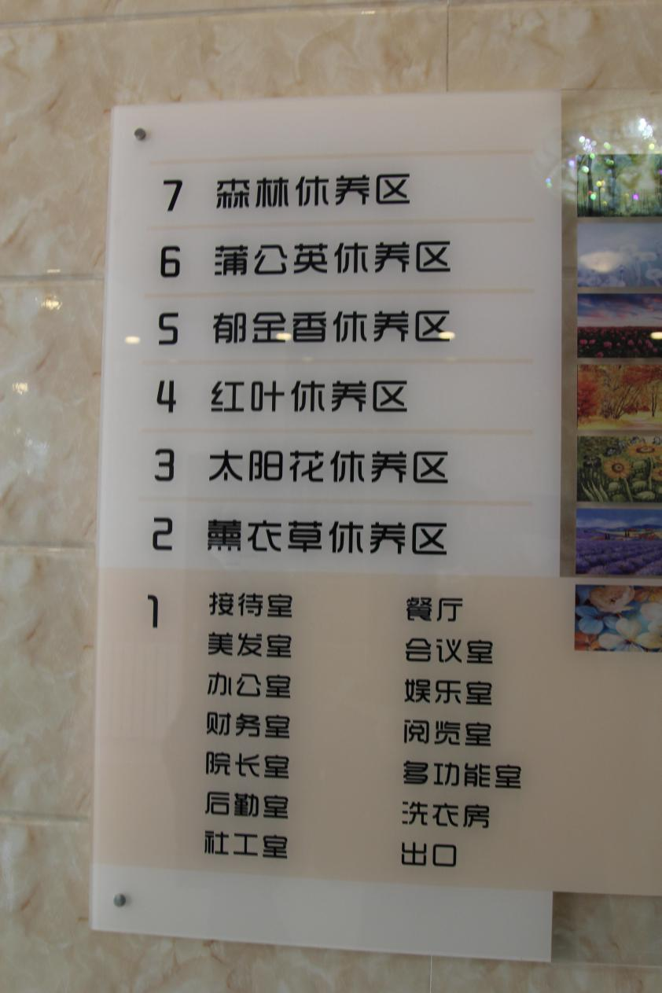

Slide 29
2.Community home-based care for the old has also attracted a number of young people.
The government vigorously promotes the Community home-based care service for old people. By purchasing service,it brings in a number of emerging elderly care institutions entering services, providing health, medical care, entertainment and elderly care. The group management, chaining operation, standardized service and domestic environment also absorb a large number of young people to work in the elderly care services and social work.
3.Social recognition of elderly care service staff and social workers has been gradually increased.
Most of the young people are highly educated, they can accept new things quickly and have scientific service concepts and methods. Therefore, social recognition and professional prestige are gradually enhanced. At present, the government also attaches great importance to the selection of outstanding personnel from the staff engaged in social service industry. A considerable number of outstanding service personnel have been elected as NPC members, CPPCC members, leaders of mass organizations, and participants in political discussions.

Slide 30
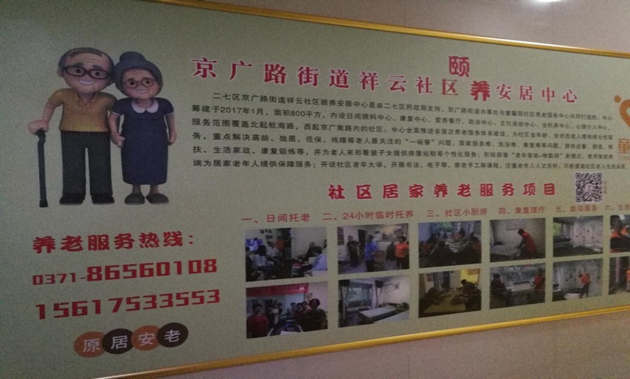
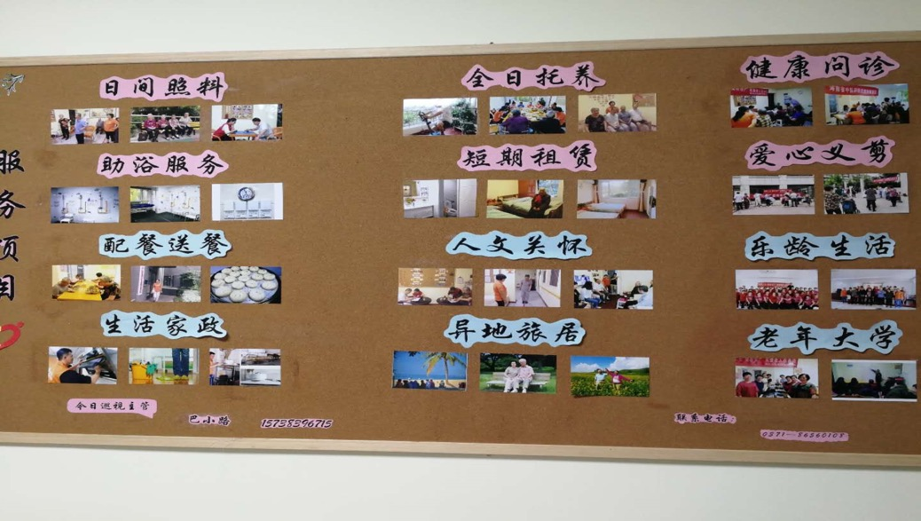
郑州市二七区
社区养老服务中心
日间照料，全日托养
健康管理，生活家政
配餐送餐，助浴服务
异地旅游，老年大学

Slide 31
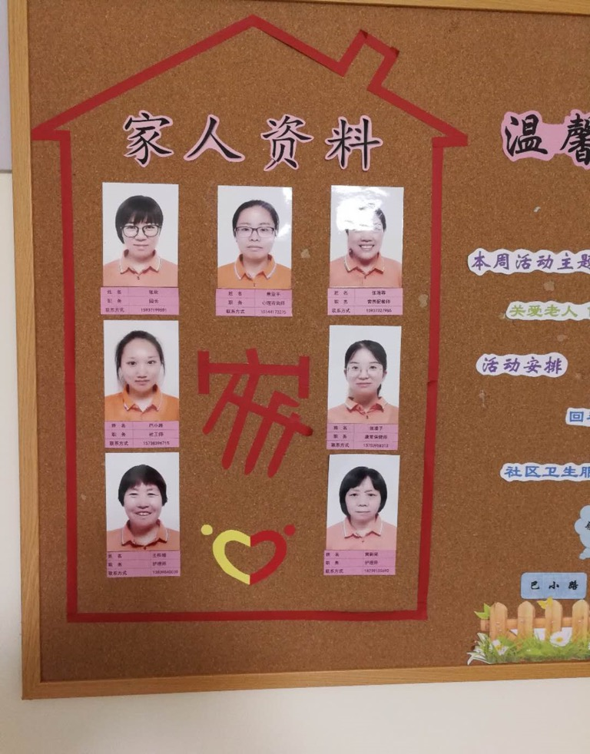
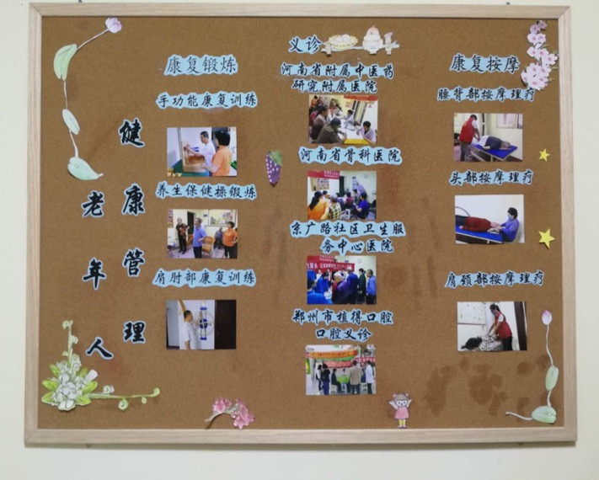
养老服务人员包括：
园长
心理咨询师
营养配餐师
社会工作师
健康管理师
护理师

Slide 32

谢谢！

