Slide 1
From Aging before Getting Rich to Gradually Rich and Speedy Aging: The Multi-State Forecasting on Super-Aging in China(2018-2100)
Hong Mi Prof.& Executive Director
School of Public Affairs, Zhejiang University
The Institute for Population and Development Studies, ZJU
The Laboratory for Population Big Data and Policy Simulation, ZJU
25-26 Sep. 2018

Slide 2
Background and Significance
For China, the next 30 years is the turning point of Chinese population as our society is entering the “Gradually Rich and Speedy Aging” period.
Furthermore, the structural unbalance of social aging service source is getting sever.
The first solution is to construct a sustainable social aging service financing system which combined the medical care and based on the limited finance concept.

Slide 3
Background and Significance
According to the situation of developed countries, when the country gets the aged society, the Per Capita GDP is about 5000$ to 10000$. But the Chinese situation is that China may face the aged society before accomplish development. And for the hysteresis of aging service system, the society is not ready for the aged problem.
The characteristic of Chinese aging society is economy new normal，aging population and longevity population structure.

Slide 4
Background and Significance
Frist is the tendency that “Gradually Rich and Speedy Aging”. According to the NBS(National Bureau of Statistics),the Per Capita GDP is rising from 945$(2000) to $9000+(2017). In the mean time, the ratio of people over 60 and 65 raise from 10.46%,6.96% to 17.3%,11.4%.

Slide 5
Background and Significance
Second,China is facing aging problem. We have now officially entered the aging society which means the disabled and solitude elderly is rising too. And the aged problem is getting more and more complicated and sever.
Third, the longevity appears multi-healthy status. By the end of 2015, the expected life expectancy is76.34，1.51 year longer that 2010.
Thus, “Gradually Rich and Speedy Aging” is a big challenge to our scale and structure of medical resource demand.

Slide 6
Research Objectives：Population Prediction on Multi-health Status
Population Prediction on Multi-health Status：Clarify the objectives of aging service system.
Purpose: Prediction the elderly population by age, sex, residence，health and disabled status from 2011 to 2100. Prediction on eight type of people: child,teenager, adults, elderly from urban and rural area and working and retired people from urban area.

Slide 7
Study Structure
1.Preface
2.Data and method
3.Construction of Multi - State Prediction Model for Chinese Population
4.Multi-state population projections
5.Conclusion

Slide 8
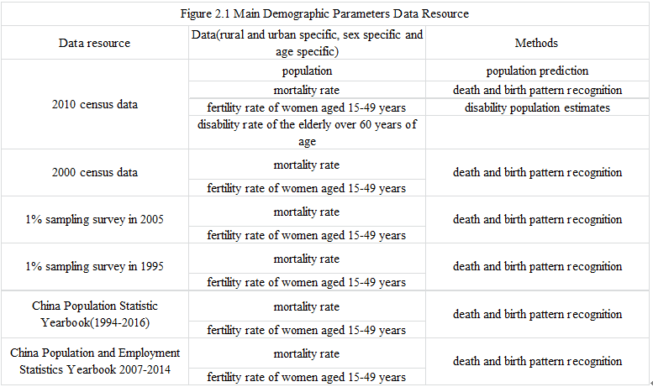
2. Data and Method
2.1Data Resource--Macro

Slide 9
2. Data and Method
2.1 Data Resource—Microscopic
1）Sample Survey of the living conditions of the elderly in urban and rural China: year of 2000,2006,2010
2）Dynamic Monitoring Data of Floating Population
This data is about living condition, migration characteristic, employment and income, social integration,mental health, basic public service,basic medical service and basic social insurance etc.

Slide 10
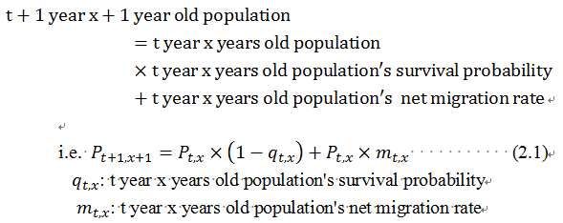
2. Data and Method
2.2 Method— Population Prediction
（1）Above 0
（2）0 Years old

Slide 11
2. Data and Method

Slide 12
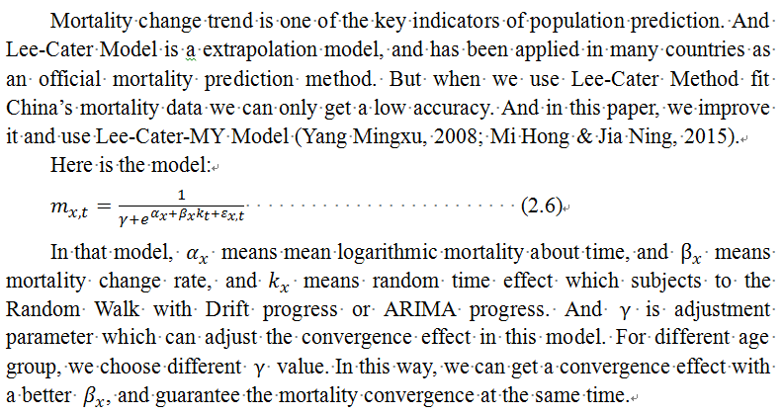
2. Data and Method
2.2 Method—Mortality Prediction Model

Slide 13
2. Data and Method
2.2 Method—Longitudinal Data Analysis Method
In this report we used the random effect model and generalized estimating equation model based on the SSAPUR data characteristic.
random effect
model：
Generalized Estimation Equation Model：The dependent variable in this report is Disable or Healthy(0/1), Obey Bernoulli distribution.

Slide 14
3.Model Construction
3.1 Base Population Revision
Reason:The underreporting of infant and young children especially the female.
In this report, the revision of underreporting of young children and birth sex rate, we use the method of Hong Mi and Mingxu Yang(2016). As for the number of fatal deaths by age, we take the Wang Jinying(2013) method.
3.2 Birth
We assume that before 2030 when the urban and rural integration shall be finished the TF will rise.And after 2030, the TF will be like current Asian developed countries and areas that fall back. And we set the end value of total fertility to 1.5.

Slide 15
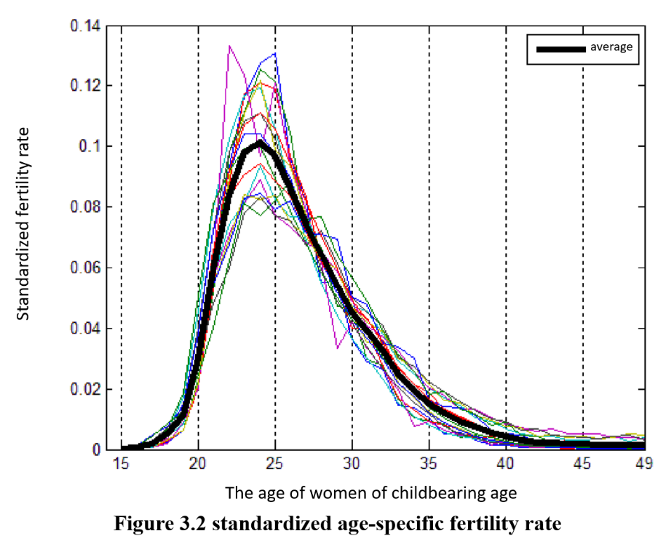
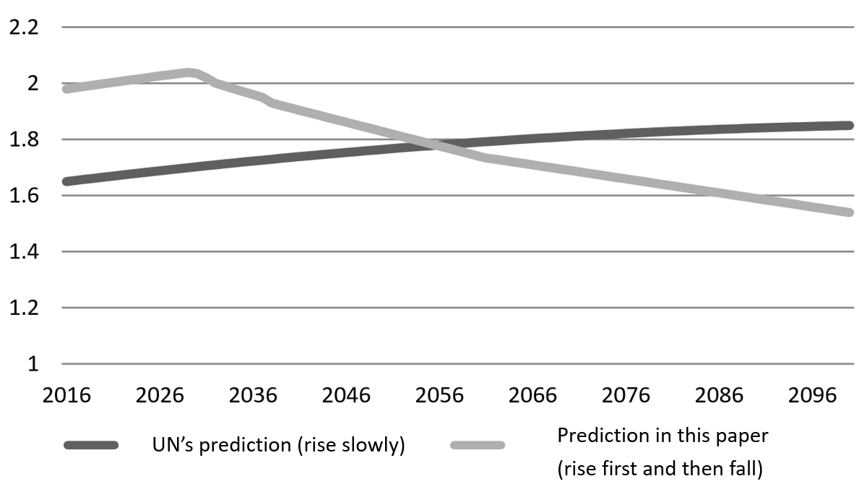
3.Model Construction
3.2 Birth
The age-specific fertility rate of women aged 15-49 years of
age from 1997 to 2013 was standardized by 0-1 and find out their mean

Slide 16
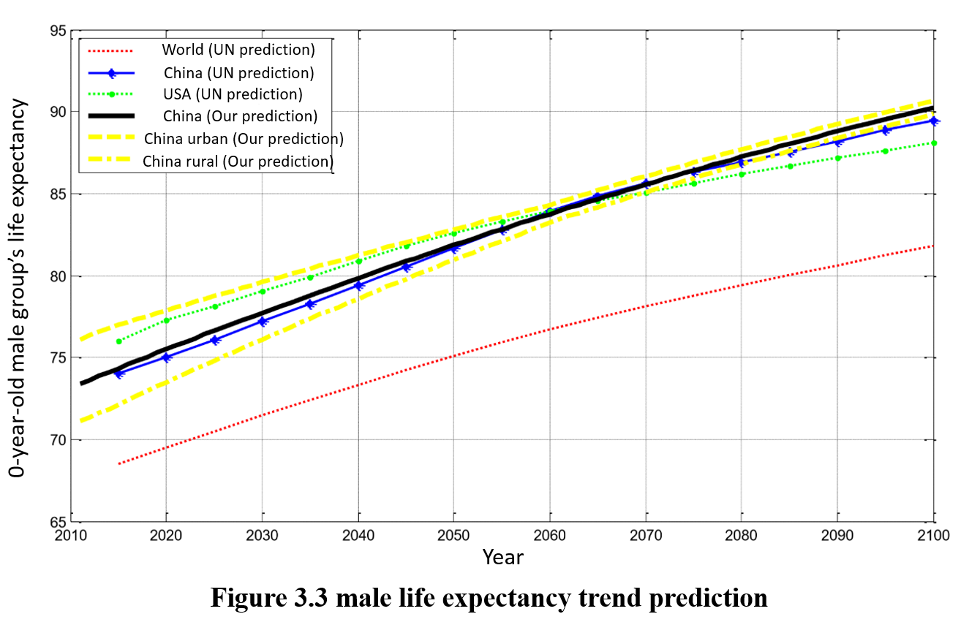
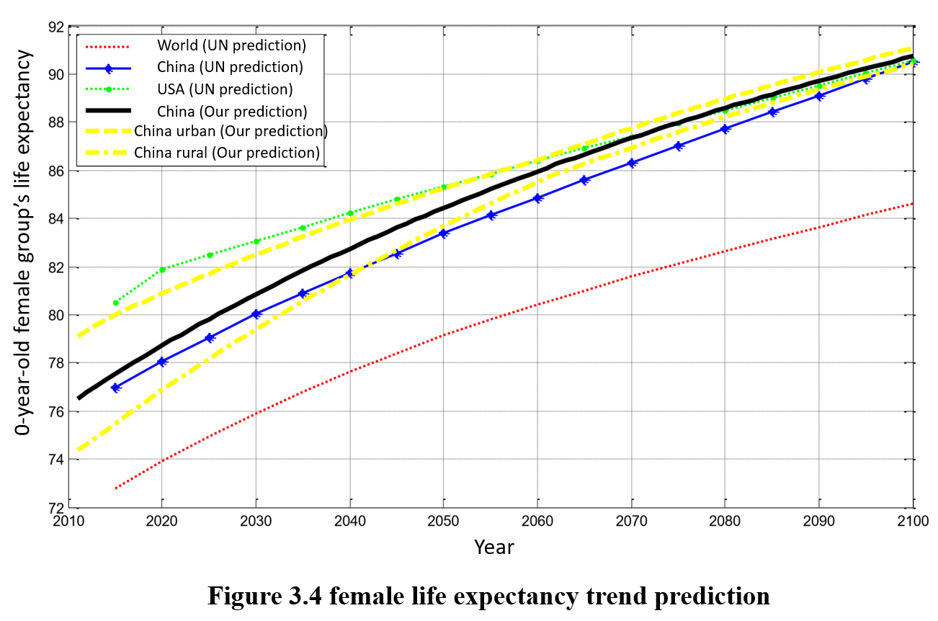
3.Model Construction
3.3 Death
The prediction of life expectancy is little higher than the UN prediction which means the Lee-Carter-MY model’s single year mortality is little lower than the UN value.

Slide 17
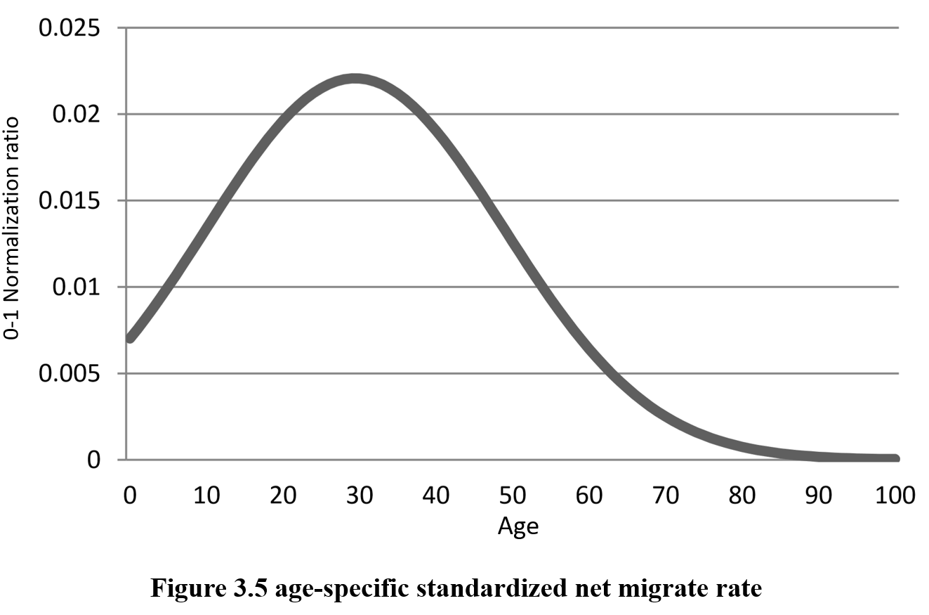
3.Model Construction
3.4 Migration
This report sets the peak rate of the urbanization of China in 2050 which is between 72.5% to 75%, then the stabilizes at this level. We set every year about 2% of the population migrate from rural area to city,then decreased linearly to 5‰ in 2050.

Slide 18
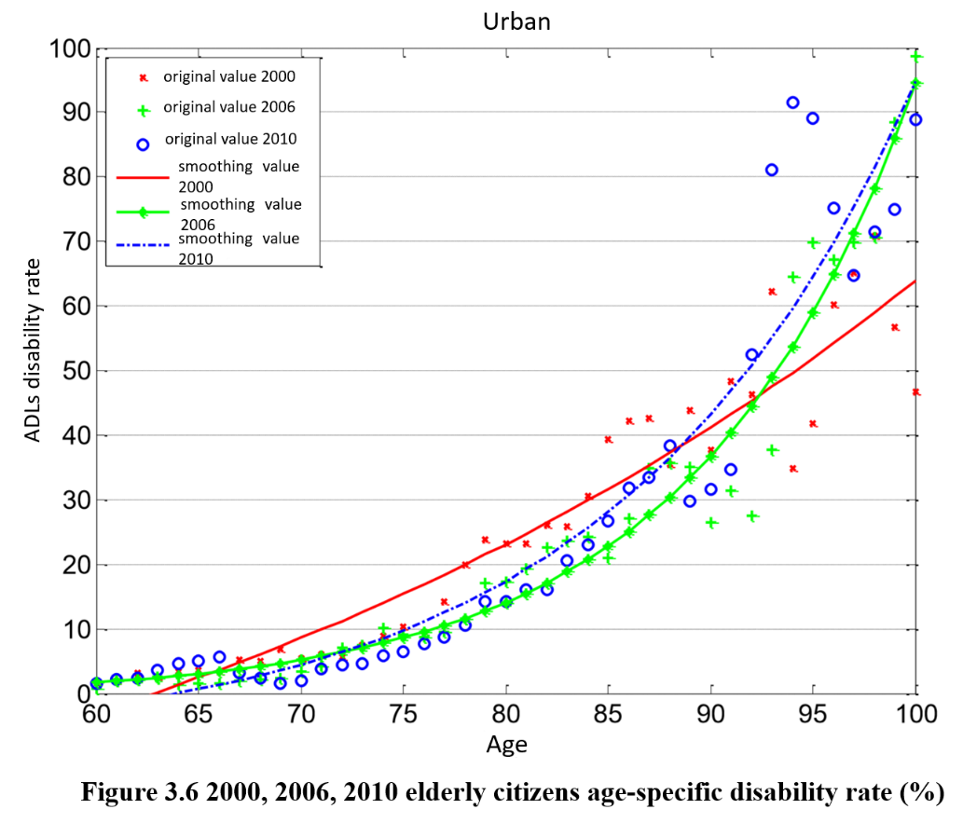
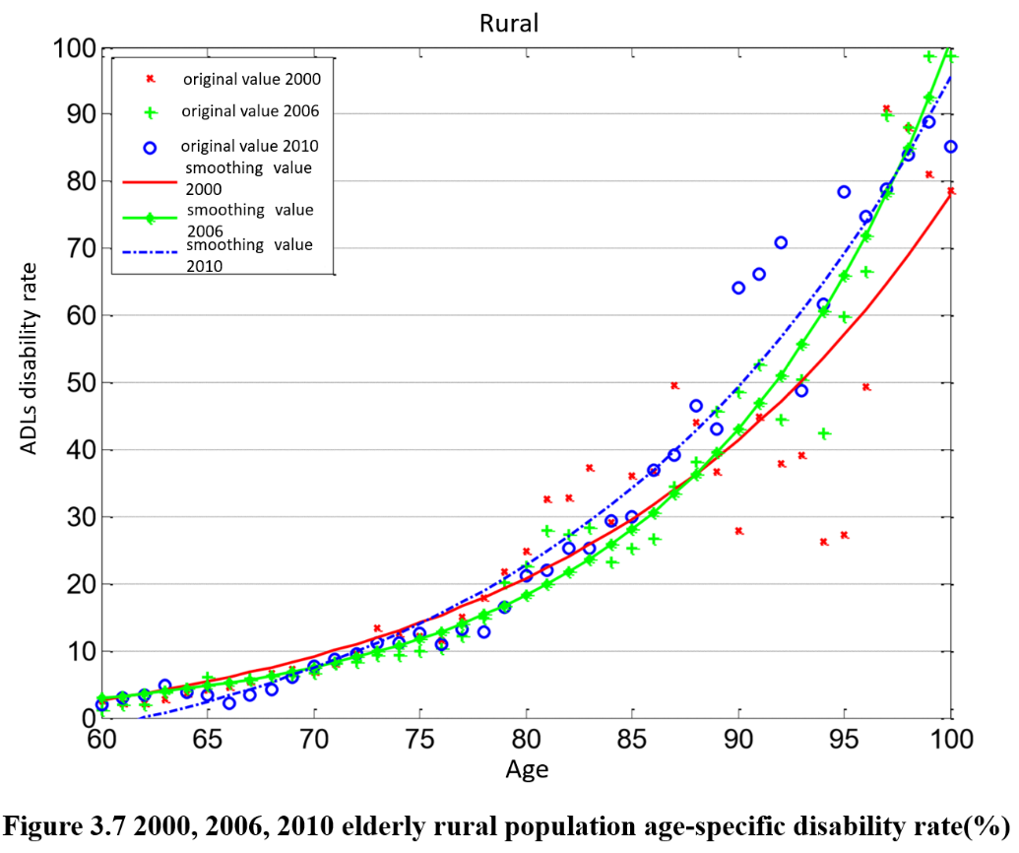
3.Model Construction
3.5 Health
1. The tendency of disability rate:

Slide 19
3.Model Construction
3.5 Health
2.Conclusion:
In 2010 and 2006, the overall rate of disability rate decrease relative to 2000. Urban living in general is conducive to health; whether the workers have health insurance shows no significant on improvement in the role of health; the number of children more, instead is against the health.
3. Assumptions:
1)By 2060, all people over the age of 60 have a high school education and above;
2)By 2060, the income of the elderly over 60 years of age is three times that of 2010;
3) The average life expectancy increased to 84 years by 2060;
4)The level of urbanization increased from 51.3% in 2011 to about 73% in 2060 (the urbanization rates in the two fertility scenarios will be slightly different)
We make the prediction that in 2060 the total disability of the elderly over 60 is 8.21%. So in the future the relationship between health and longevity of elderly will be in a dynamic equilibrium.

Slide 20
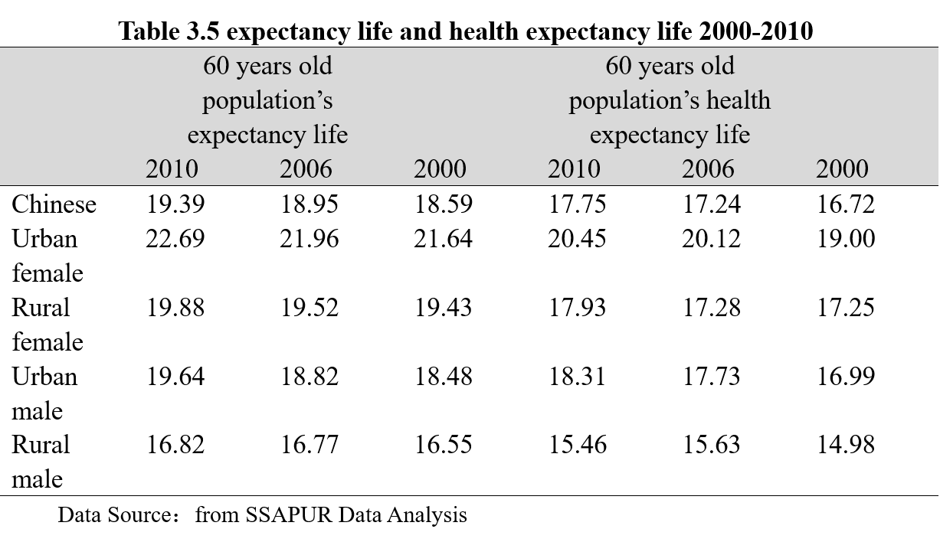
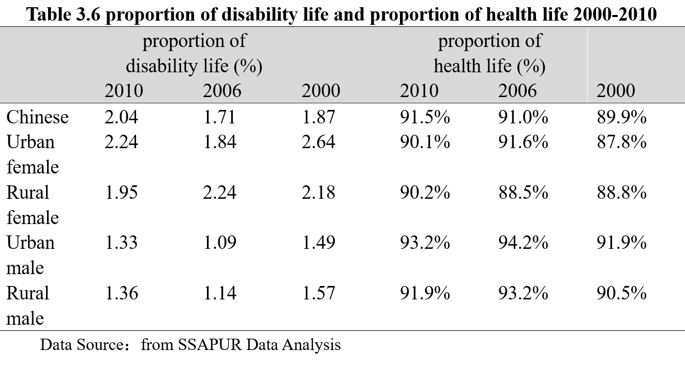
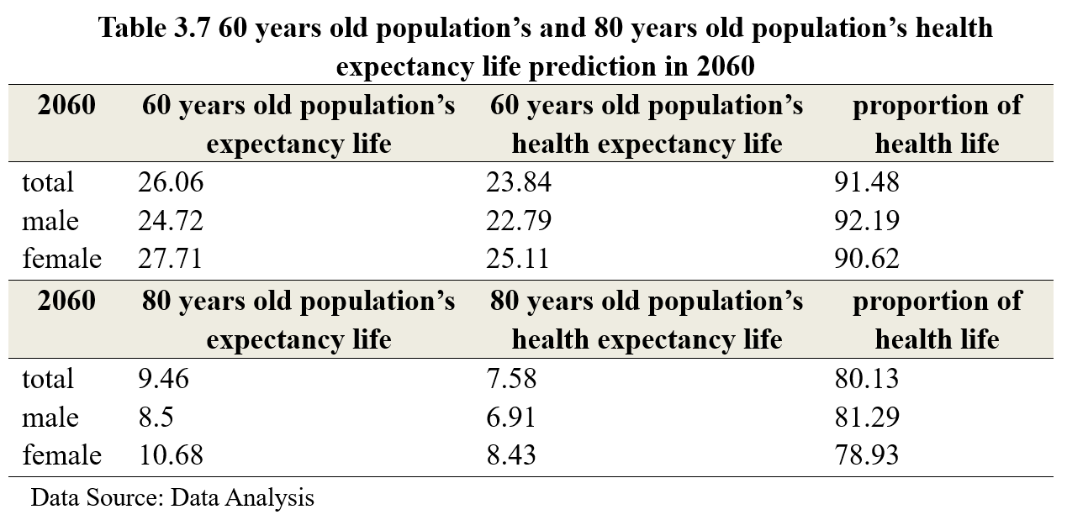
3.Model Construction
3.5 Health
Health Expectancy
Based on Sullivan Method, by 2060, the average life of elderly over 60 is up to 26.6. And the health expectancy life is about 23.84, so the health life expectance is 91.48% of the whole life expectancy which is basically the same level of 2010

Slide 21
3.Model Construction
3.6 Social Insurance Insured Status
1.Urban Working Staff:
2.Urban Retired Staff:
3.Citizens(Children)
4.Citizens(Adults)
5.Citizens(Elderly)

Slide 22
3.Model Construction
3.6 Social Insurance Insured Status
6.Rural Residents(Children and Teenager)
7. Rural Residents(Adults)
8.Rural Residents(Elderly)

Slide 23
4. Multi-state population projections
In the following illustration,
The left picture shows scenario 1 mode (the fertility mode set in this report)
The right picture is the Scenario 2 model (the United Nations model of fertility prediction).
This report randomly predicts 100 times, so most of the forecast results is the band interval.

Slide 24
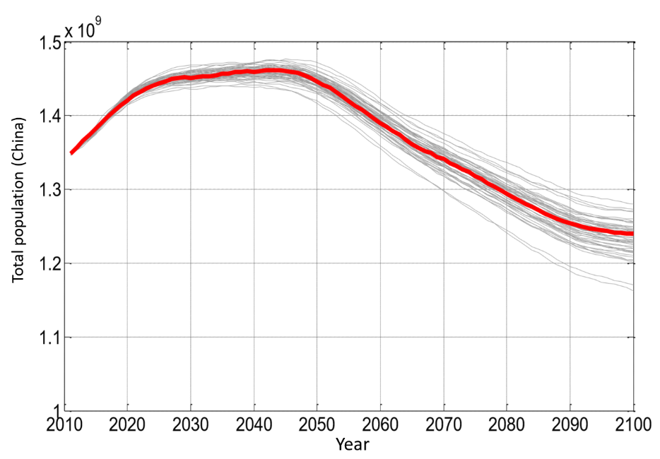
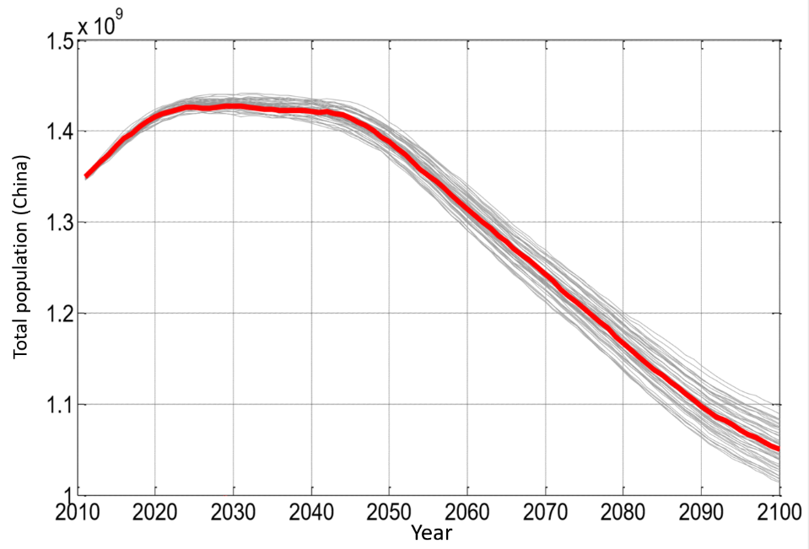
4. Multi-state population projections
4.1 Total Population
In scenario 1, the total population reaches 1.45 billion in 2025, and peak value 14.68 in 2044. In 2100, the total population is about 1.23billion. In scenario 2, the peak value comes at 2030 about 1.435 billion and decreases rapidly after 2050, finally reaches 1.005 billion in 2100
This difference is mainly because the women at childbearing age in our country still got great number during the next 20 years.

Slide 25
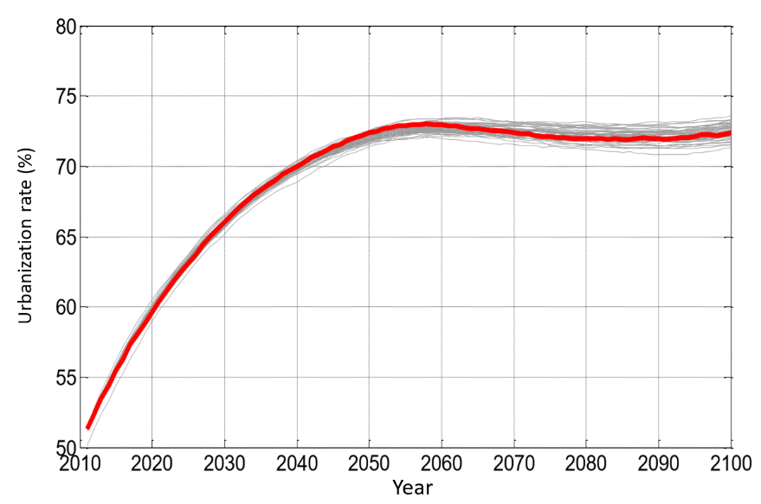
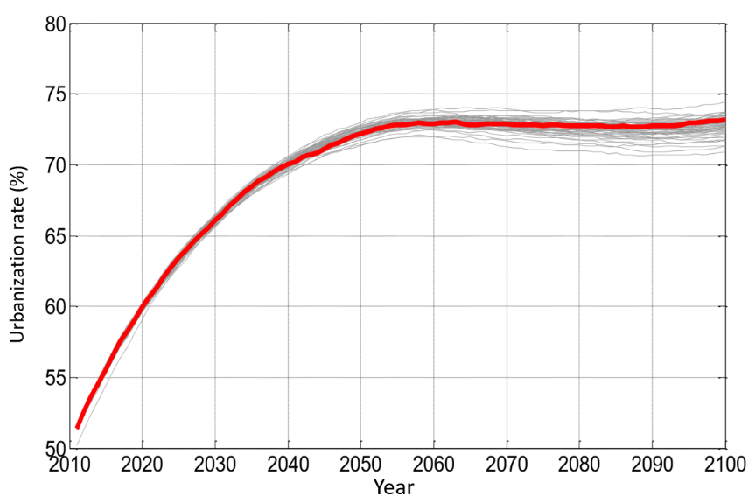
4. Multi-state population projections
4.2 Urban and Rural Population
1. Urbanization Rate
The urbanization rate in scenario 1 will exceed 70% in 2040 and peak at about 72.5% in 2060, and then stabilize at around this level.
In scenario 2 the peak rate is over70% in 2038, and 73.5% in 2058, and then stabilize at this level.

Slide 26
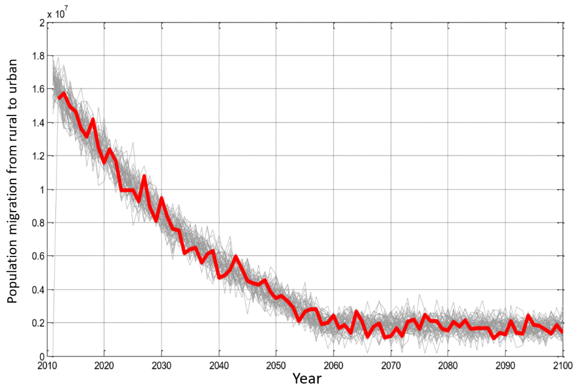
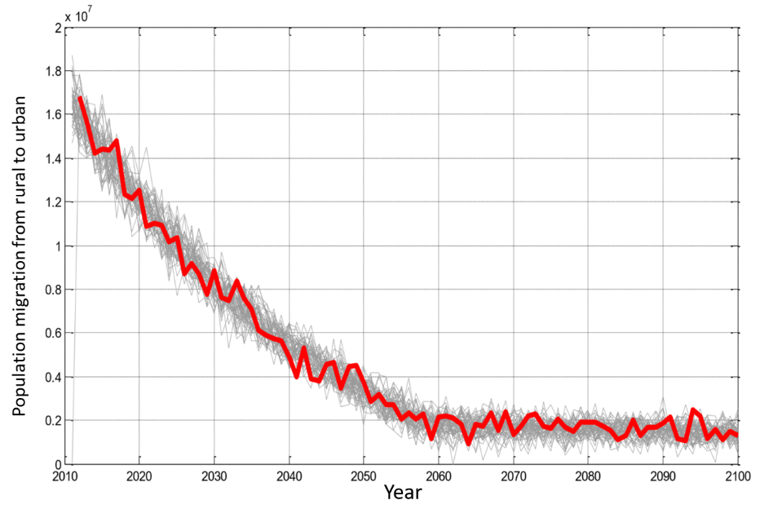
4. Multi-state population projections
2. Rural net migration population
The projected population migration from rural to urban dwellers will gradually decrease from about 16 million at present to about 4 million per year ,and by the year of 2050 will stabilize between 1.5 and 2.5 million.

Slide 27
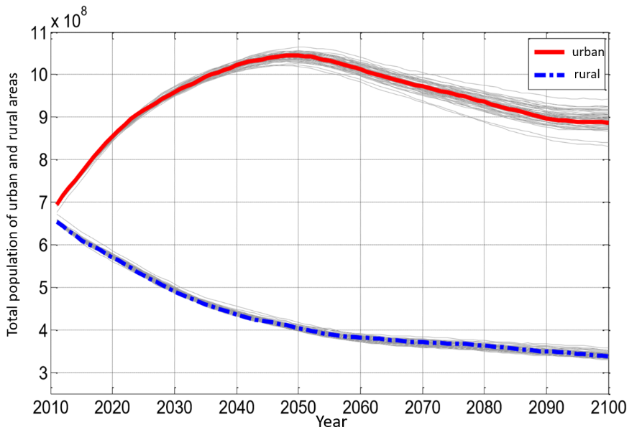
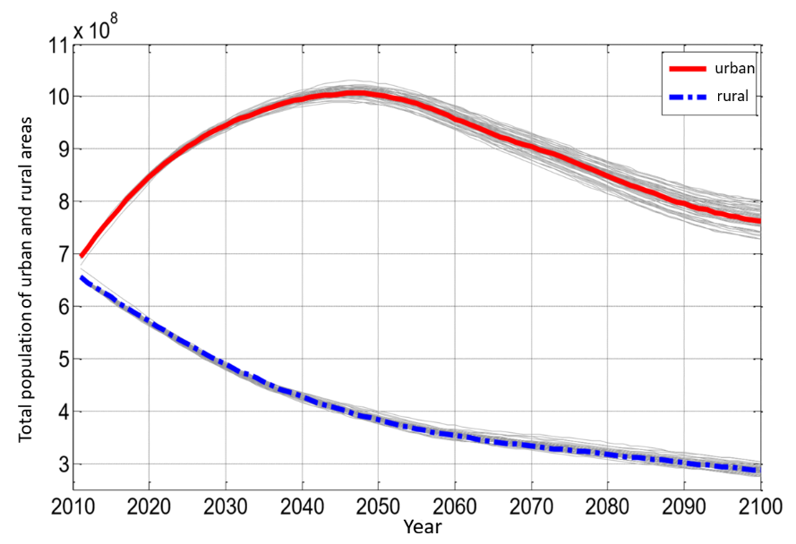
4. Multi-state population projections
3. Total population of urban and rural areas
Urban population will continue to increase during the next 35 years by 2050 or so to stop. The peak of the urban population is about 1.05 billion in Scenario One.
While the population living in rural areas will continue to reduce the trend of reduction in 2100 to 300 million to 350 million.

Slide 28
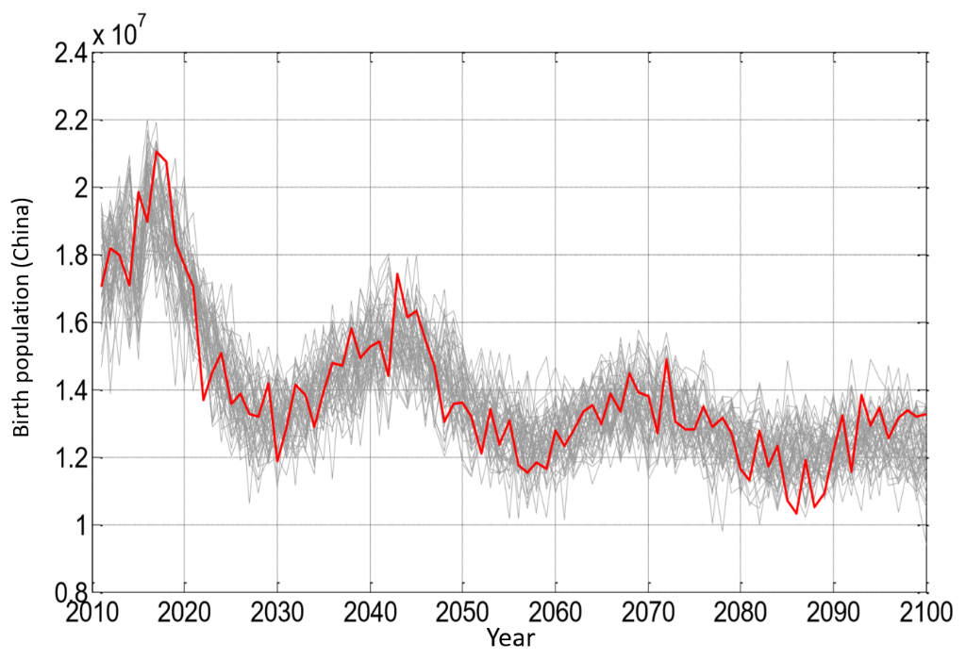
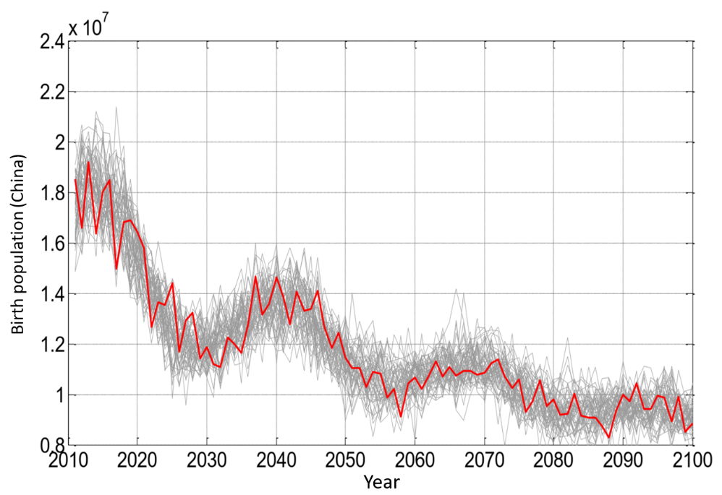
4. Multi-state population projections
4.3 Birth and Death Population
1.Birth
However, due to limited population structure, the late birth
of its population will still be low. And finally between 8 million and 10 million per year fluctuations.

Slide 29
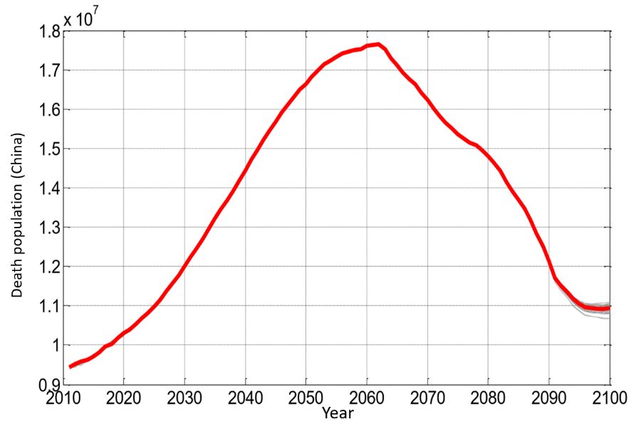
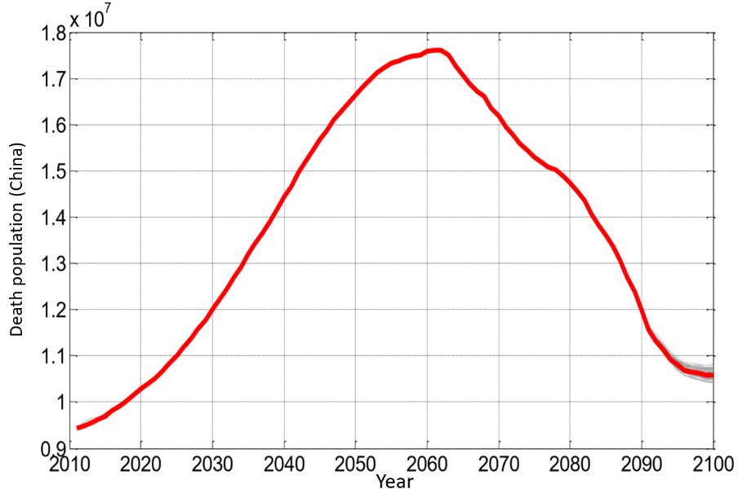
4. Multi-state population projections
2. Death Population
The death population will not be affected by the birth rate in the early stage of the forecasting phase. The current annual death population is about 9.7 million, and it will continue to grow in the past 40 years, reaching a peak in 2062, or about 17.7 million deaths per year. 2062 after a rapid decline in the death toll in 2100 between 10.7 million -11 million, still higher than the current level.

Slide 30
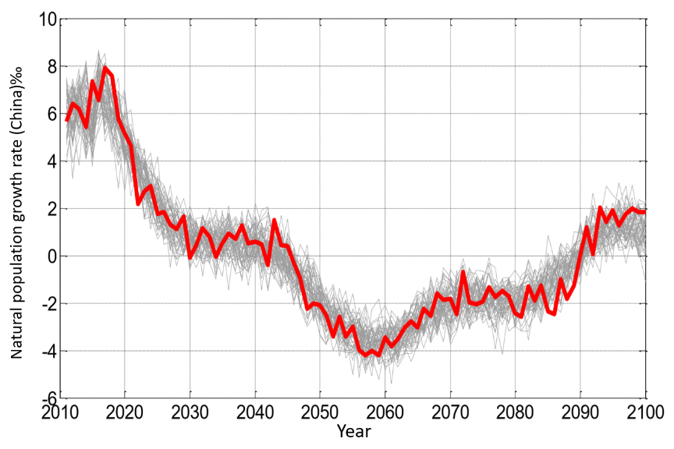
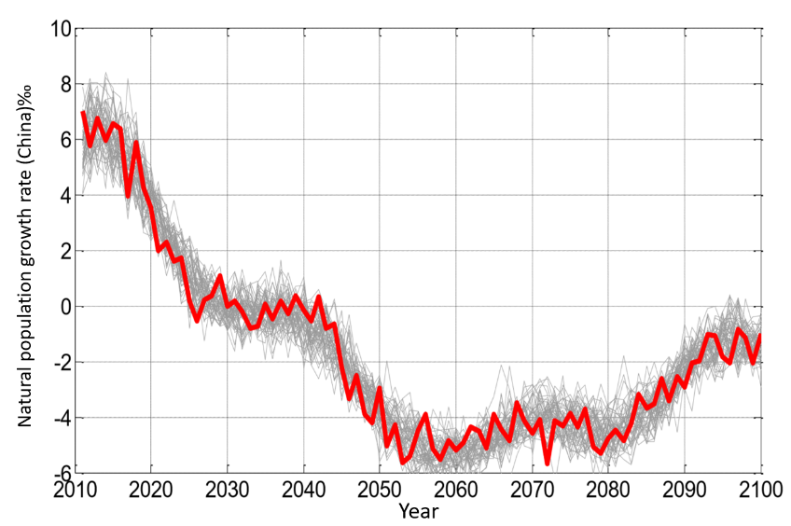
4. Multi-state population projections
3. Natural population growth rate
The tendency of Natural population growth rate in scenario 1 and 2 is basically the same, but 1 is higher than 2. The natural population growth rate of the year 2016 is about 7 ‰ -8 ‰. After the decline in volatility, Scenario 1 in 2045 into a negative growth, Scenario 2 in 2025 began to fluctuate around the 0 growth in 2042 officially entered the negative growth.

Slide 31
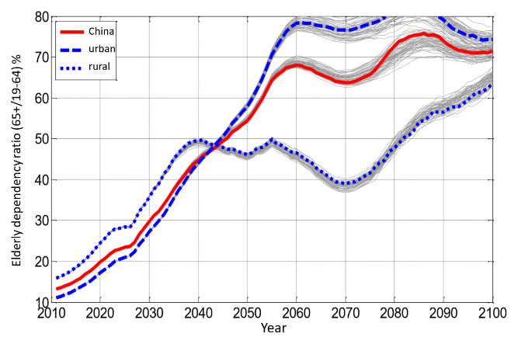
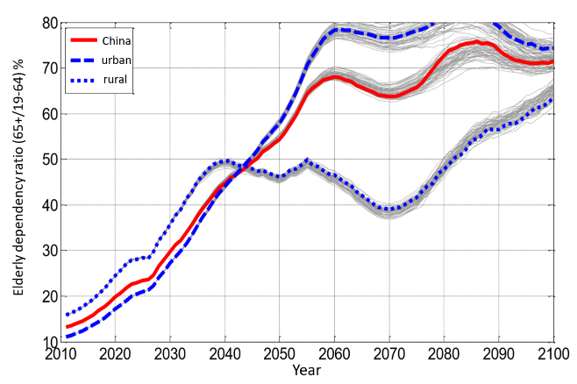
4. Multi-state population projections
4.4 Aging Index
1. Population aged dependency ratio
The National Aged Dependency Ratio will reach a peak of 65% in 2060 in Scenario 1, which means that a young person corresponds to 0.65 elderly.
Scenario 2 will have peaked at 75% in 2085. The aging level of cities and towns due to the impact of pre-population migration in 2043 before the level of aging is lower than in rural areas, and then will begin significantly higher than rural areas.

Slide 32
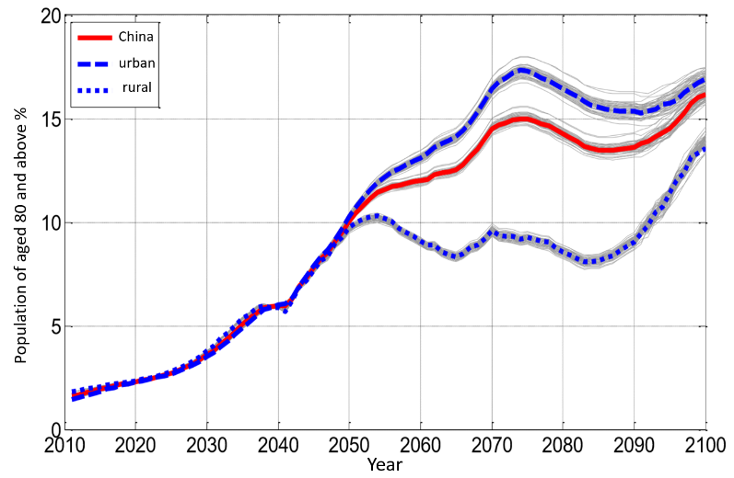
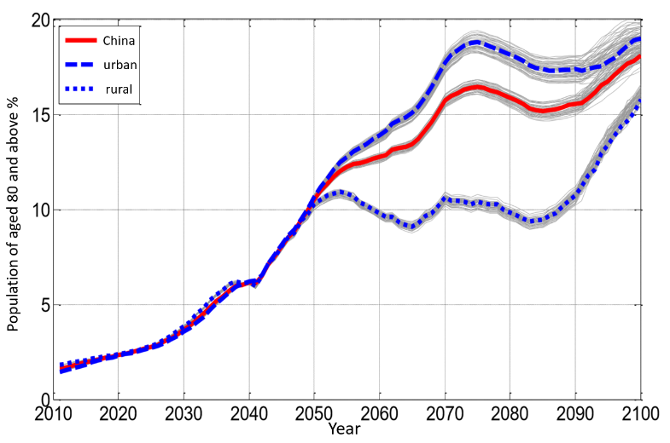
4. Multi-state population projections
2. The proportion of the elderly population
This report defines the population aged 80 and above as the senior population. Nationwide, the general trend is likely to continue to increase over the next 80 years. It is currently 1.85 per cent and by the year 2060 will be about 12 to 13 percent, and 16 to 18 percent by 2100. Rural and urban aging levels will remain at almost the same level before 2050, after which rural areas will remain at a certain level for about 40 years while towns continue to grow.

Slide 33
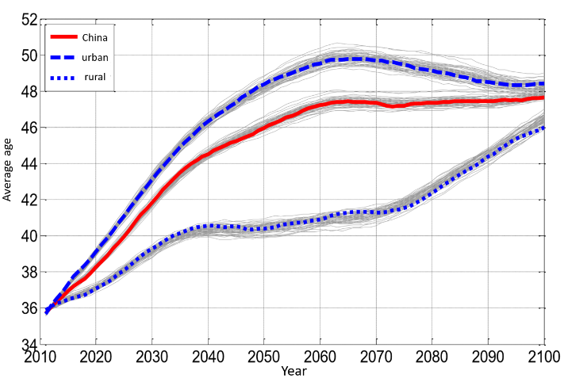
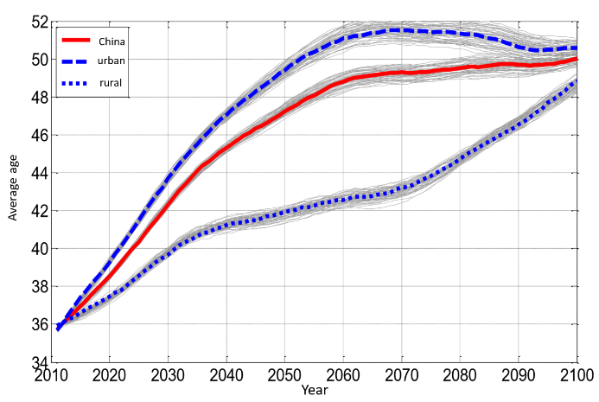
4. Multi-state population projections
3. Population Average Age
At present, the average age of the whole population in China is about 37.5 years old, and then will continue to increase, scenario 1 in 2064 will reach a peak of 47.5 years. In the scene 2 will peak more than 48 years by 2064. The average age of the towns is higher than that of the countryside.
This report considers that during the period from 2016 to 2030, it is China's window window for aging society reform. Once you miss this period, the future situation will be very serious.

Slide 34
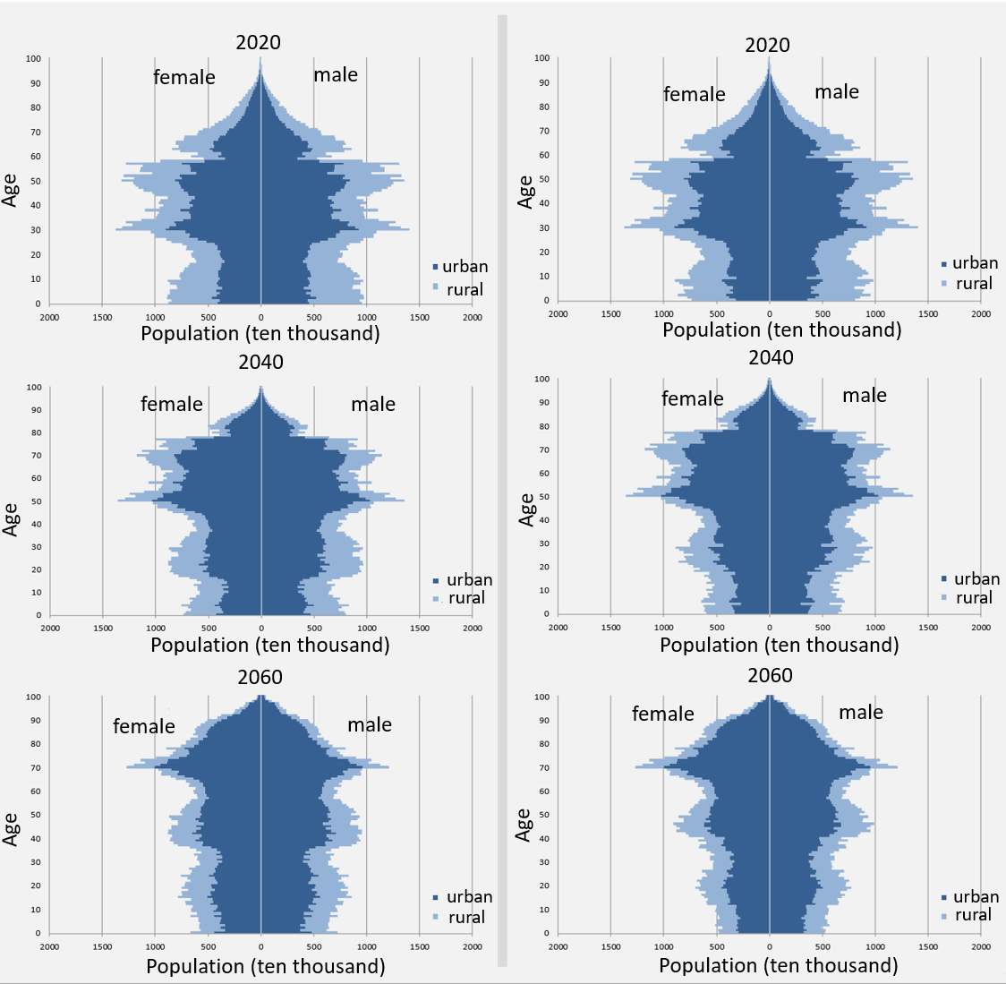
4. Multi-state population projections
4.5 Population Pyramid
No matter scenario 1 or 2, our population age structure is going to appear sever “zigzag” style for our fertility policy.
No matter how fertility policy adjustment, about 50 years are difficult to change this dilemma

Slide 35
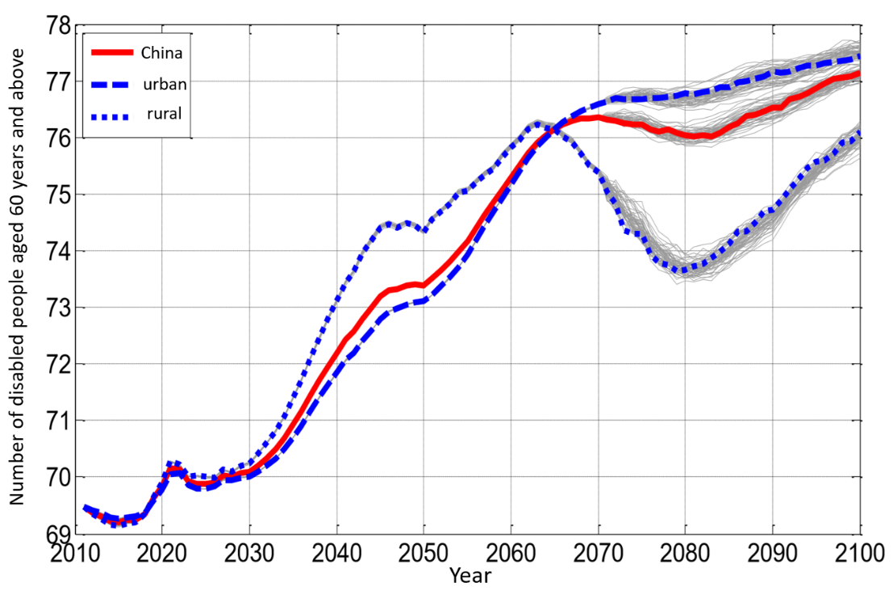
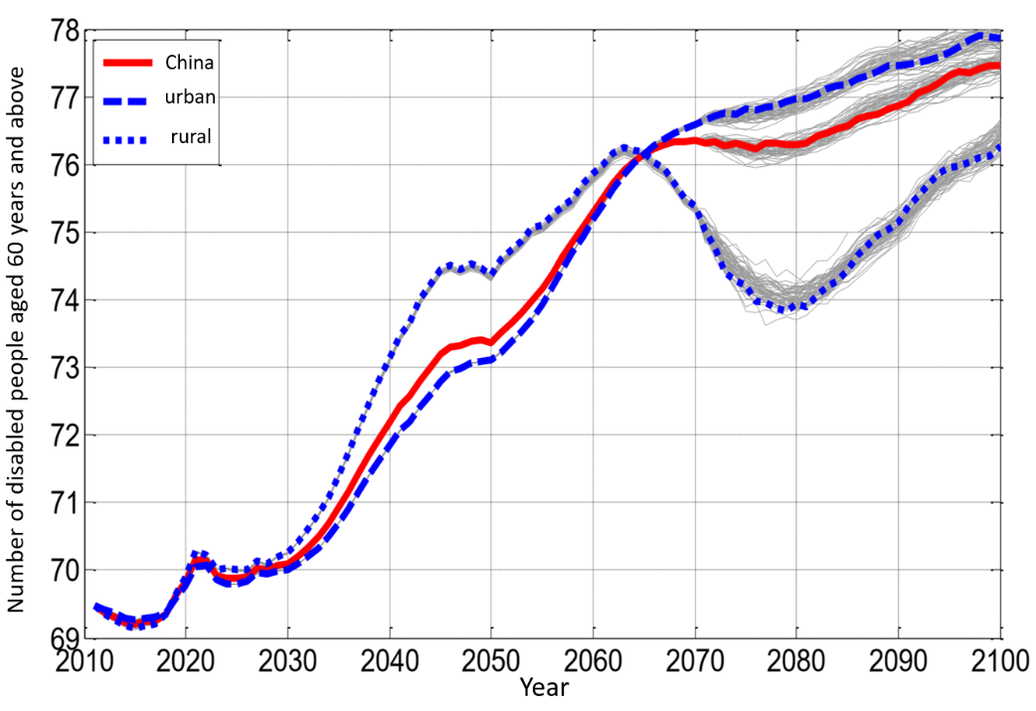
4. Multi-state population projections
4.6 Disabled Elderly
Disability is the primary predictor of this report because it is a direct counterpart to long-term care policy.
There is no difference in the total number of disabled people aged 60 years and over until 2070 in both scenario 1 and 2.
At present, China‘s total disability elderly over 60 is about 17 million, including about 700 million people cannot live on their own, and the remaining 10 million according to this report defined as semi-disabled elderly. The total demographic population and totally unable to take care of the population are consistent with the future growth trend, reaching a peak of 43.5 million and 16 million, respectively, in 2054, which will be about three times today. In 2060, will be about to 43 million and 15 million.

Slide 36
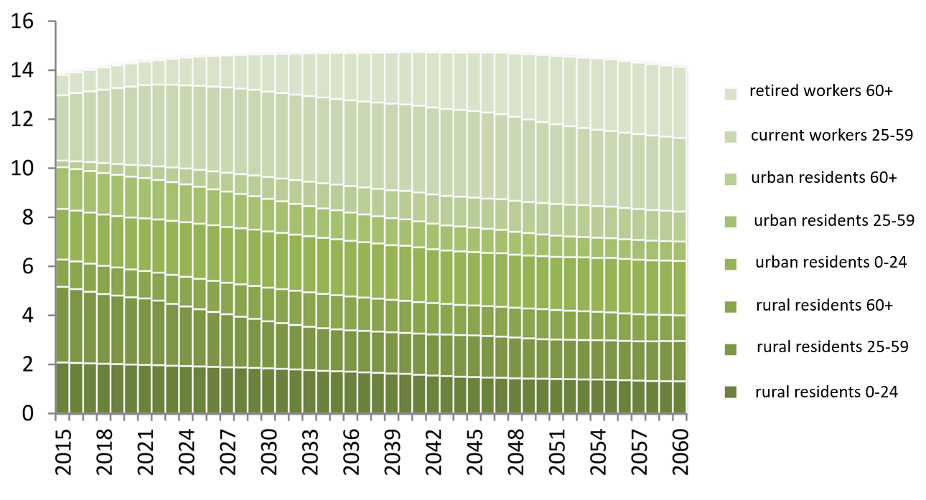
4. Multi-state population projections
4.7 Social insurance coverage of the target population
According to the current classification of insurance coverage groups, the predicted population trends of the eight groups are shown in the figure below. This report only lists the scenaio 1 result. As shown, the number of retired workers will increase significantly.

Slide 37
5.Conclusion
The New Normal State of Population Structure
China‘s natural population structure and social structure is currently in a period of rapid change.The biggest feature in this time is the aging of the intensified and highly achieved urbanization. Studies have shown that the three trends of population development in China are characterized by a reduction in the working age population, a low natural population growth rate and a significant increase in the quality of the population.
Besides the world population will continue to grow in the future. In the world with the development of global economic integration, the total population, quality, structure and distribution are the most significant factors that affect the competitiveness of all countries.

Slide 38
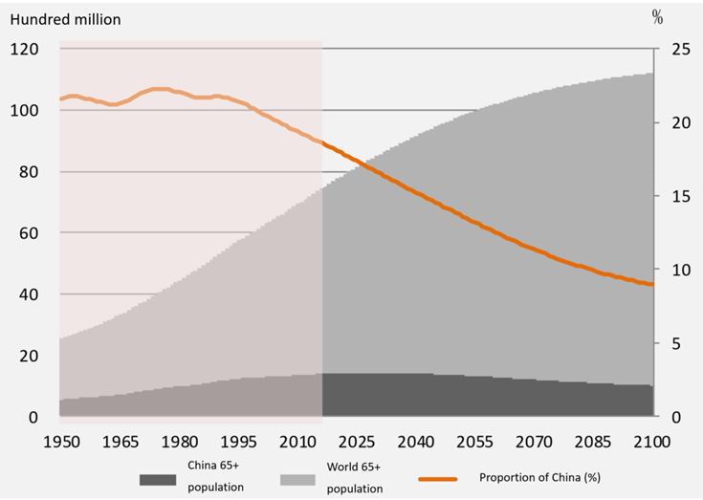
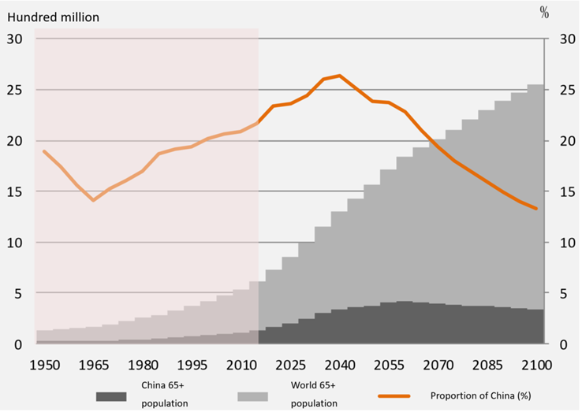
5.Conclusion
1. The proportion of Chinese people make up to the whole population will decrease, but the aging is much higher than world average level.
Till 2091, there is going to be every 10 people in the world have a Chinese person. But the for the people over 65, the situation is getting worse. The proportion of Chinese elderly remained over 20% before 2070. And it will reach peak at 26% in 2040.

Slide 39
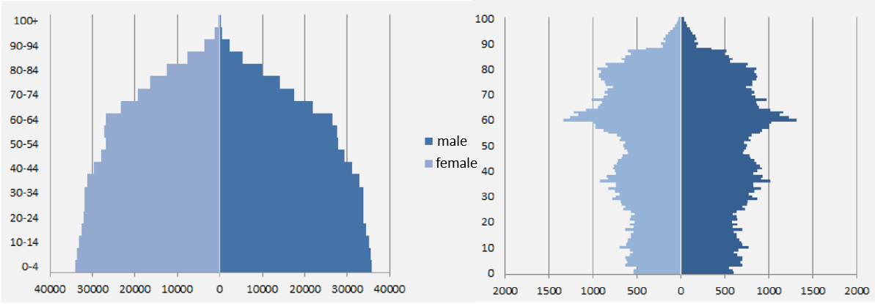
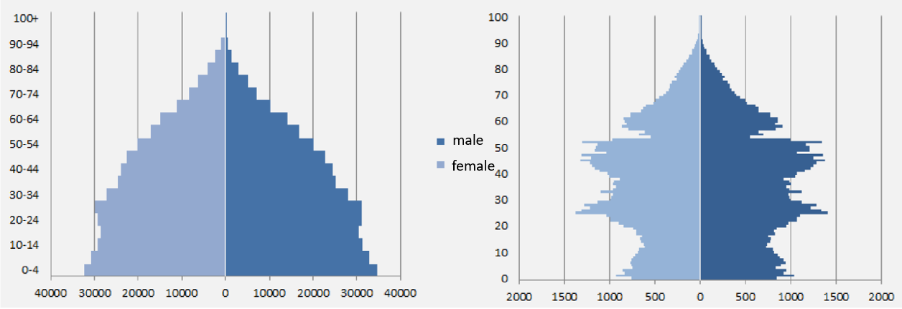
5.Conclusion
2. The "zigzag" pyramid structure of the Chinese population is unlikely to change in the next 50 years.
Figure 3.22 and Figure 3.24 show the “Zigzag”population pyramid in China and the normal population pyramid in the world. It can be said that no population policy can change such a structure from now in a short period of time.

Slide 40
5.Conclusion
3. Two significant Turning Points for Population Development:
Based on our prediction:
1)Year 2030 will be the start of Chinese“Old Aging Society”
2)Year2060 will be the symbol of stable period when Chinese population will end aging revolution and acceleration.
Thus, the “getting wealthy while aging rapidly” period and multi-state longevity development period is from 2016 to 2030.

Slide 41
5.Conclusion
4. Characteristics of Disabling Elderly
（1）Total Disability Population
According to the report, the total amount of disabled elderly in 2054 will reach a peak of about 43 million people, of which about 16 million people can not take care of themselves.
The proportion of disabled elderly people in the total population will rise from the current 1.15% to 2.1% in 2054, after 2054 will be maintained at this level of slight volatility.
In addition, China‘s annual death toll will increase from the current 9.6 million monotonous to about 17.6 million in 2062. This figure is little larger than the number of elderly people defined in this report who are unable to take care of themselves. However, the number of people aged 60 or below who die is not consistent with the number of elderly people who are unable to take care of themselves in this report which means that it is also a cross-check to indicate the accuracy of this report for predictions of disability.

Slide 42
5.Conclusion
4. Characteristics of Disabling Elderly
（2）Health Expectancy
The results of this study shows that from now to 2060, within the three assumptions of longevity and health,China is faced with the situation called “dynamic equilibrium” model, which means the extension of population life expectancy and the health expectancy of life extension increase at the same time. And the unhealthy life expectancy accounted for the proportion of the entire life basically remain unchanged.

Slide 43
Case Study:Long Term Care Practice in China ---International Comparison and Case Study of Qing Dao City
Hong Mi Prof.& Executive Director
School of Public Affairs, Zhejiang University
The Institute for Population and Development Studies, ZJU
The Laboratory for Population Big Data and Policy Simulation, ZJU
25-26 Sep. 2018

Slide 44
Thank You！

